Slide 1



Room Maistros B; Thursday, June 8th, 2017: 14-15h
Thorsten Butz
Everything you always wanted to know about file server. But where afraid to ask.

Slide 2

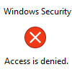
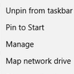
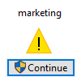
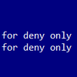
Thorsten Butz
“Everything you
always wanted to know
about file server
❊
But were afraid to ask”
❊

Slide 3








Efcharistoume our sponsors

Slide 4
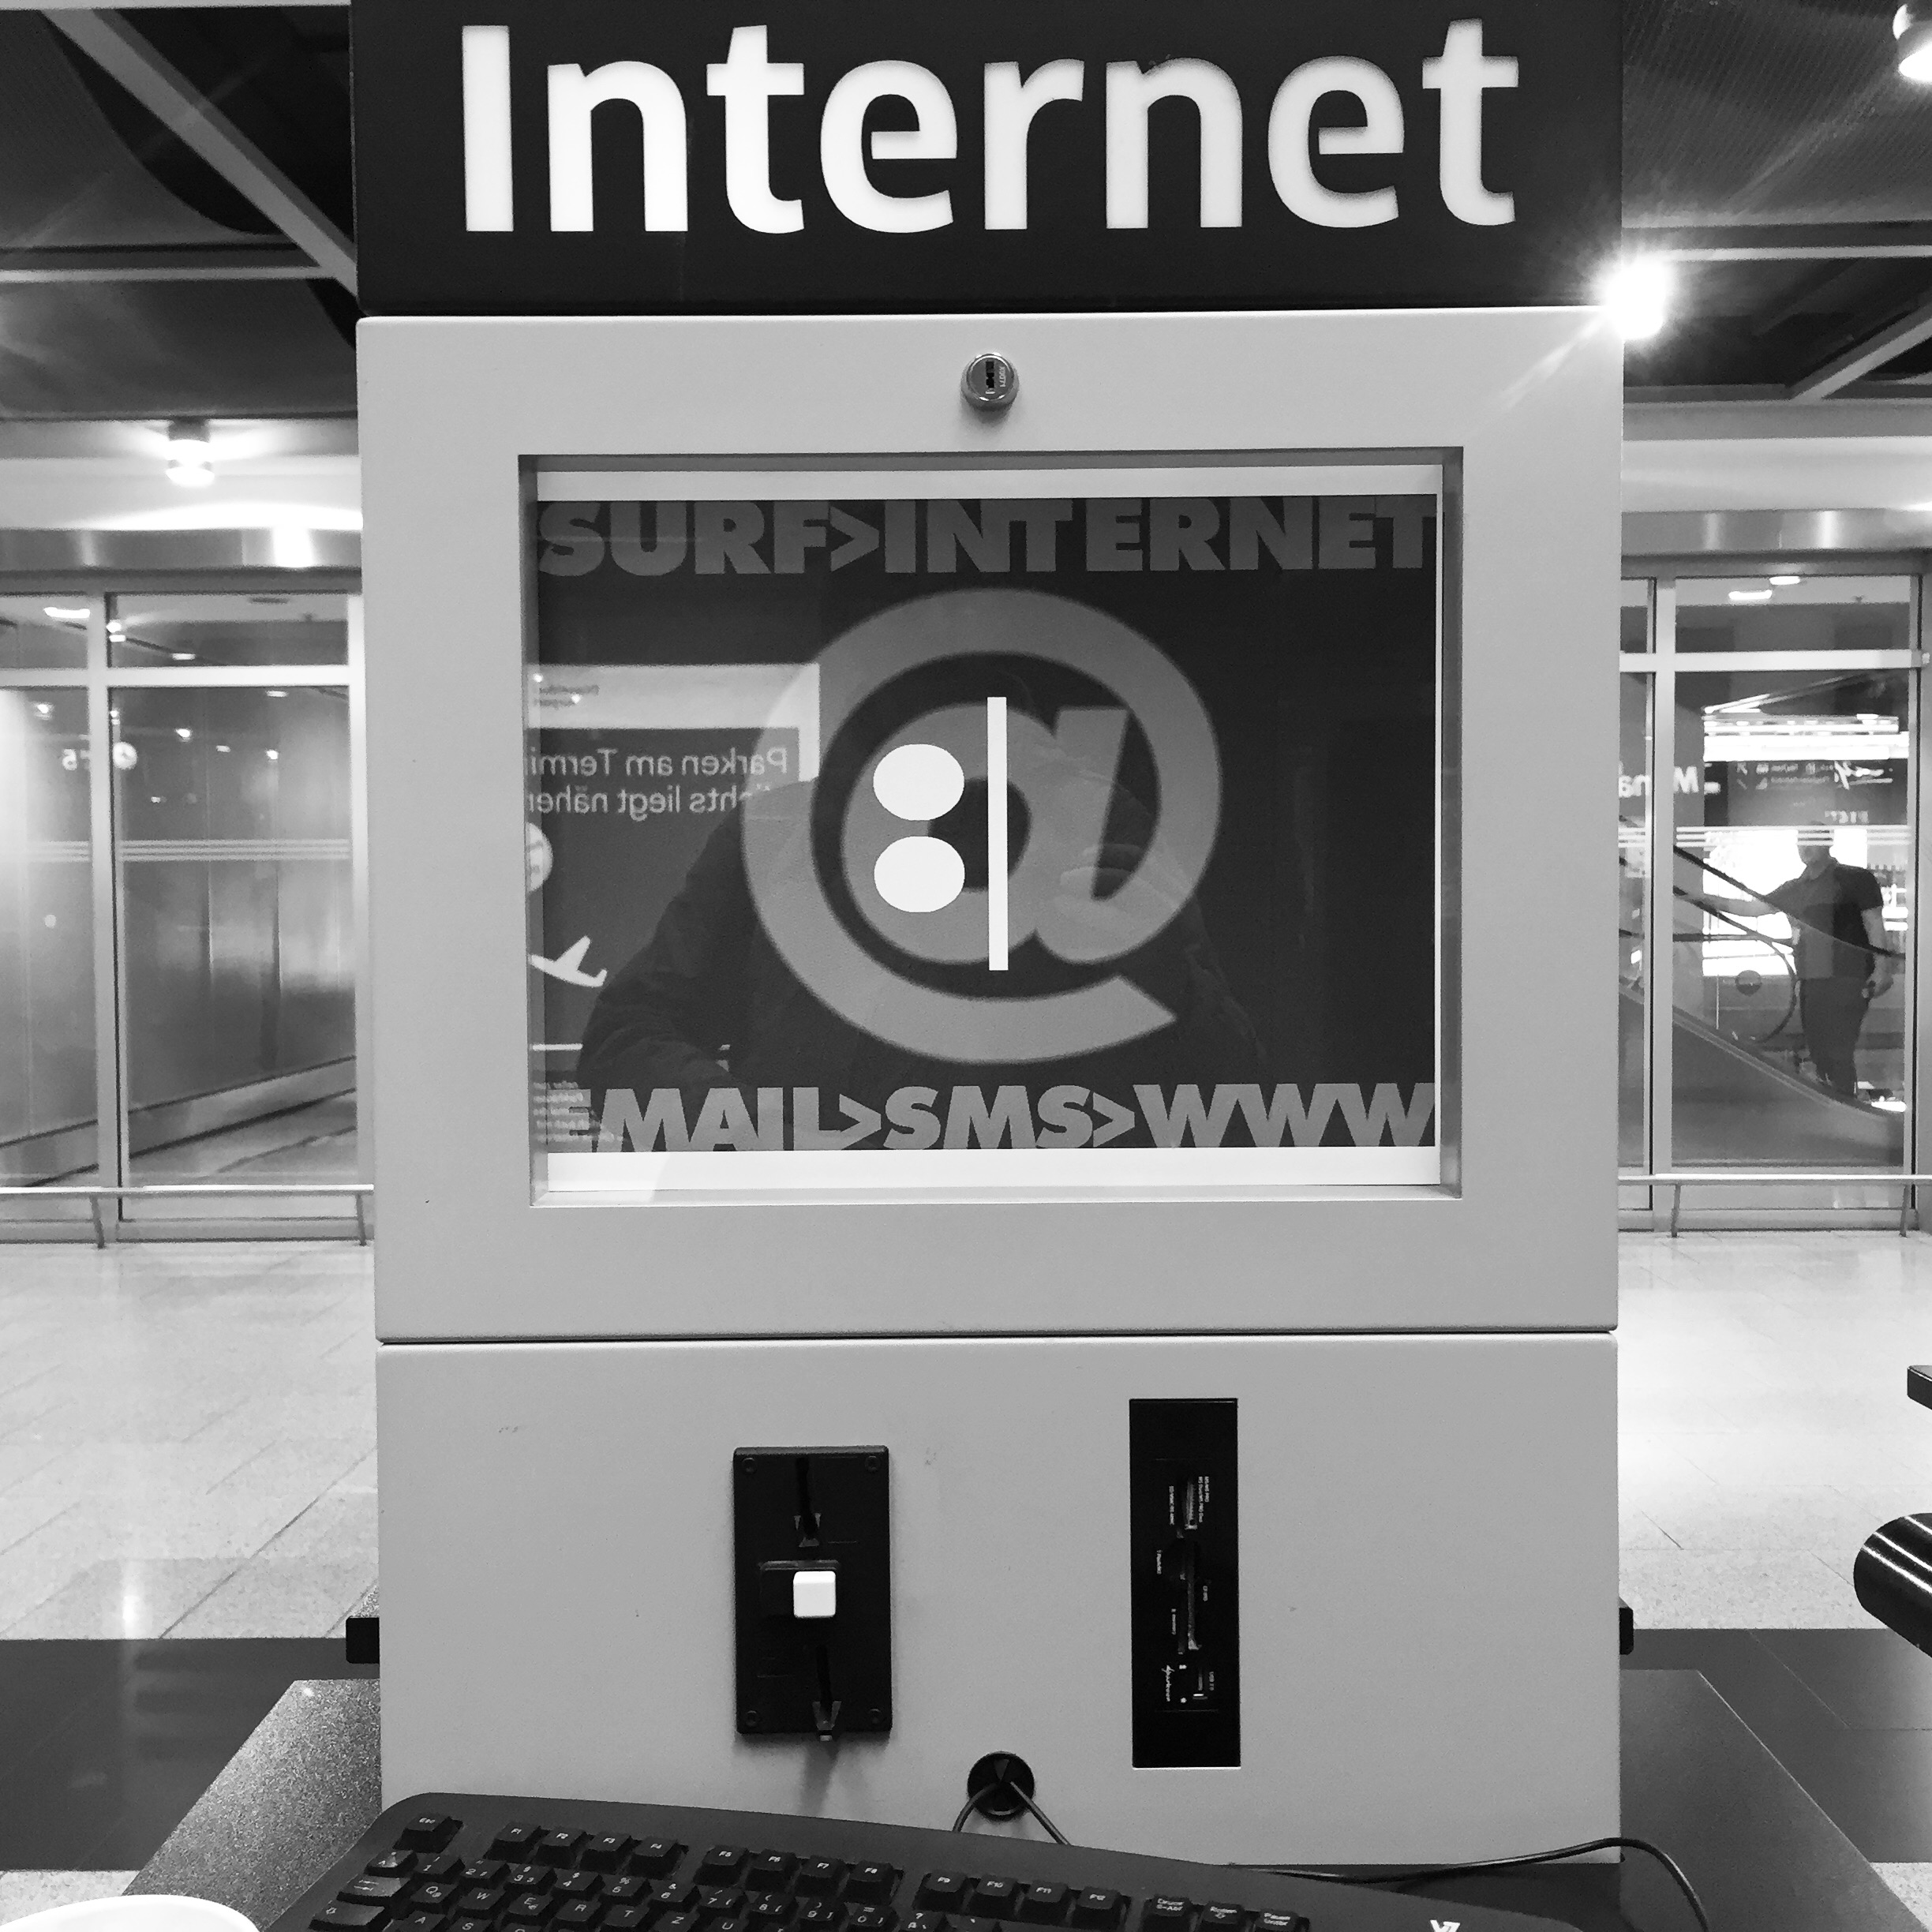


about_me
$name = 'Thorsten Butz'
$uiCulture = 'de-DE'
$mct –ge 2000
$focus = 'Scripting', 'OS', 'InterOp'
$liking = '0.0.0.0/0', '::/0'
= @thorstenbutz
= slidingwindows.de/?feed=slw-mp3

Slide 5
List of content
Episode 1: The untouchables
Episode 2: Hidden beauties
Espisode 3: Adults only

Slide 6
#region Episode 1
The untouchables

Slide 7
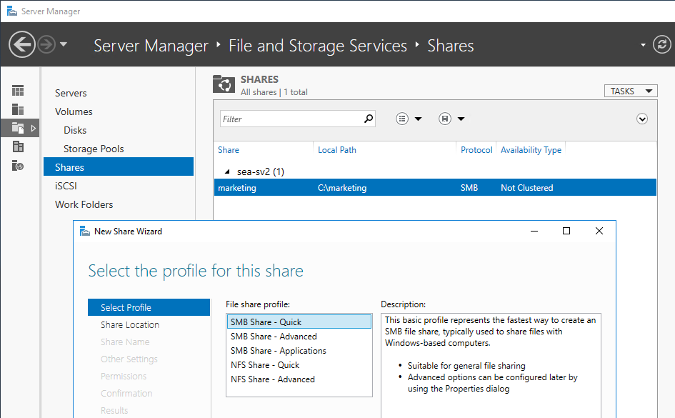
The basic stuff: remote administration

Slide 8
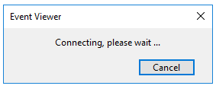
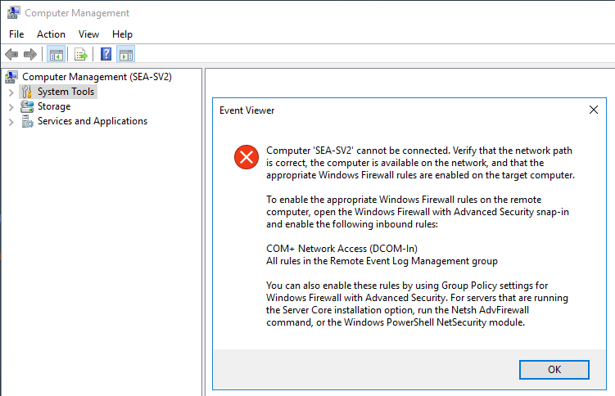
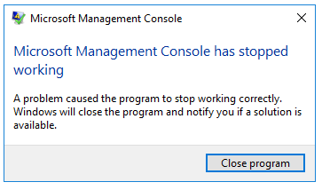
Shadows of the past

Slide 9
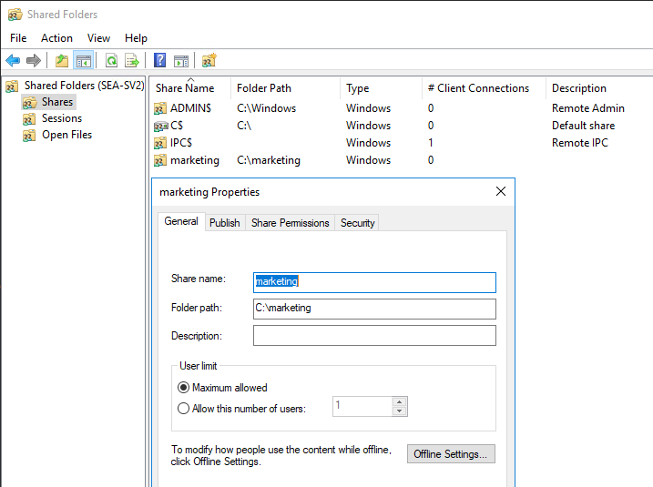
fsmgmt.msc

Slide 10
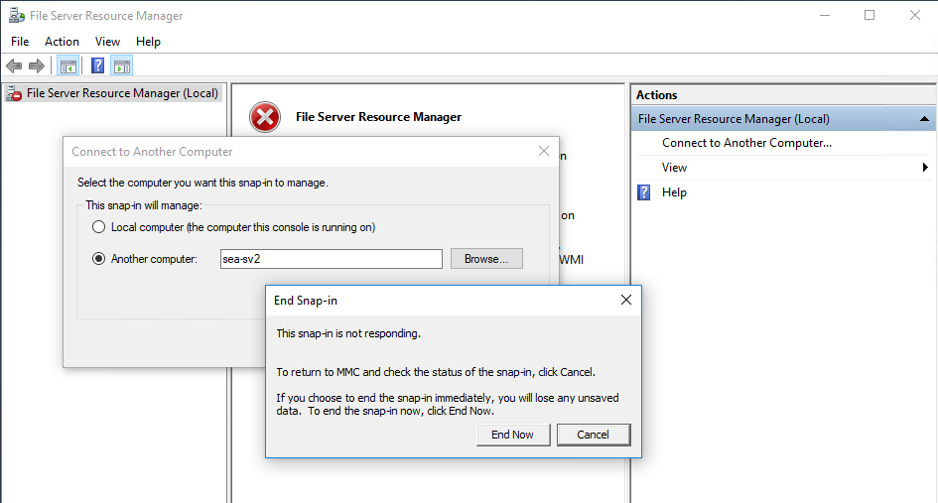
fsrm.msc
Demo

Slide 11
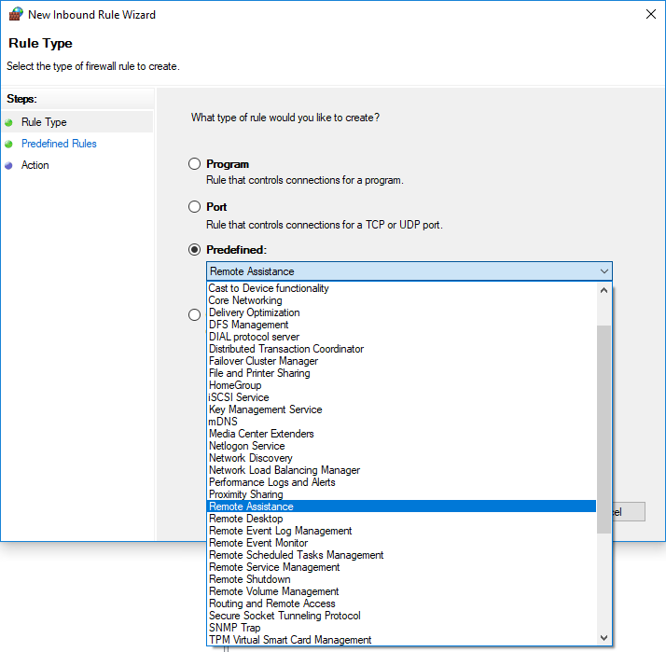
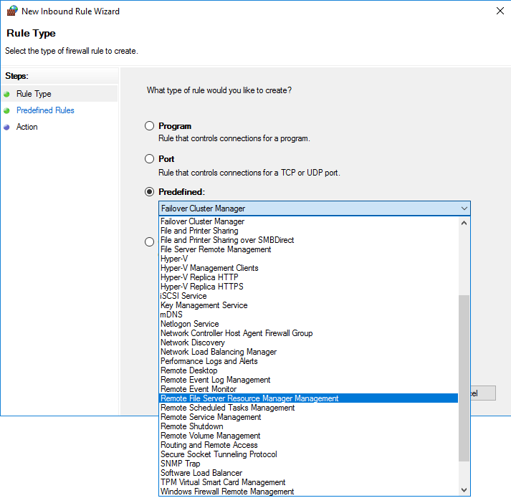
FSRM feature installed FSRM feature not installed

Slide 12

KEEP
CALM
IT'S
DEMO
TIME
Corbel 57, 28

Slide 13
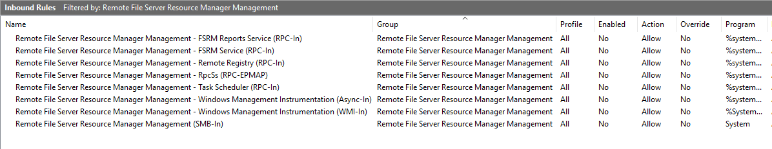
Firewall rules for FSRM
Demo
# Check config
$CimSession = New-CimSession -ComputerName $fileserver
$DisplayGroup = 'Remote File Server Resource Manager Management'
Get-NetFirewallRule -DisplayGroup $DisplayGroup -CimSession $CimSession |
Format-Table Enabled,Display*, *store* -AutoSize
# Enable rules
Get-NetFirewallRule -DisplayGroup $DisplayGroup -CimSession $CimSession |
Set-NetFirewallRule -Enabled True

Slide 14
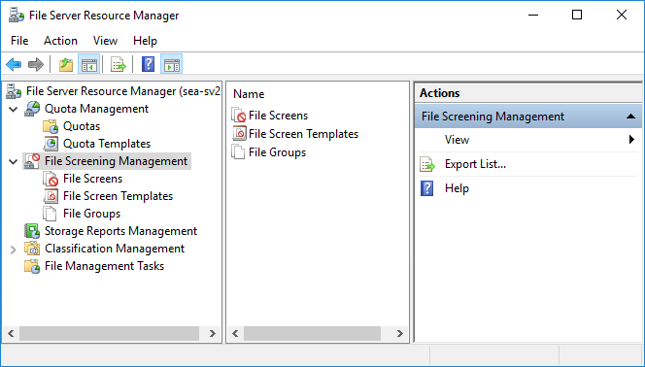
Ready for take off
Demo

Slide 15
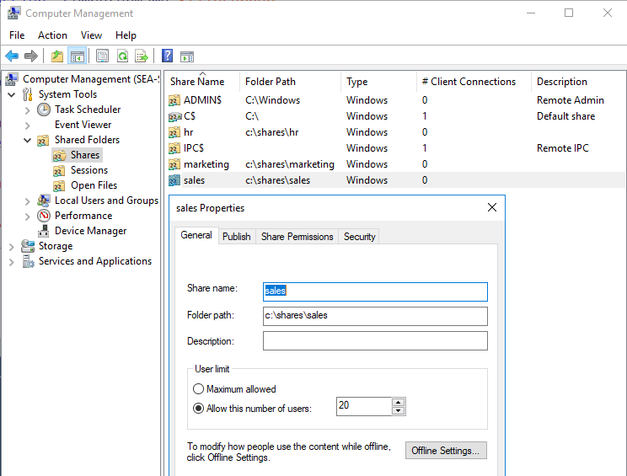
Sharing and mapping
Demo
# A
net.exe use s: \\sea-fs1\Sales
# B
New-SmbMapping
-LocalPath 's:'
-RemotePath '\\sea-fs1\sales'
# C
New-PSDrive
-Name 's'
-PSProvider FileSystem
-Root '\\sea-fs1\sales'
ab

Slide 16
#region Episode 2
Hidden beauties

Slide 17

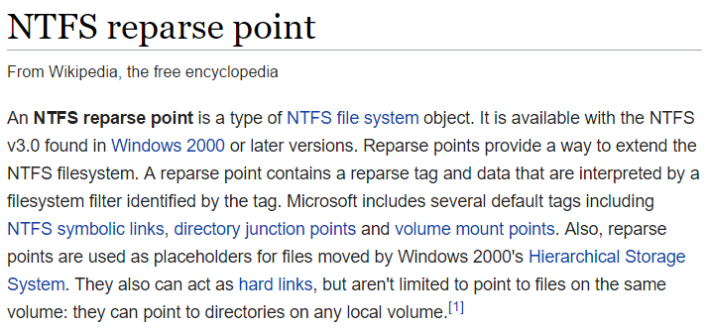
Less known NTFS object types
https://en.wikipedia.org/wiki/NTFS_reparse_point

Slide 18
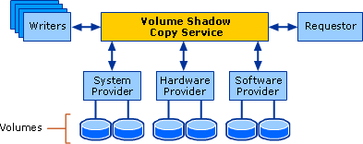
Volume Shadow Copy Service
MSDN:
"The Volume Shadow Copy Service (VSS) is a set of COM interfaces that implements a framework to allow volume backups to be performed while applications on a system continue to write to the volumes.
VSS is supported on Microsoft Windows XP and later."
vssadmin.exe list shadows
vssadmin create shadow /for=c:
mklink /D C:\vss \\?\GLOBALROOT\Device\HarddiskVolumeShadowCopy1\
vssadmin delete shadows /all

Slide 19
HardLinks, Symlinks/Softlinks
Hardlinks (files)
Can be used in file shares, cannot cross volume borders
Junctions (directories)
Can be used in file shares, can cross volume borders
Softlinks
Cannot be used in file shares, can cross volume borders

Slide 20
HardLinks, Symlinks/Softlinks
 | Hardlinks (file) | Junctions (directory) | Symlinks (file) | Symlinks (directory)
Can be used in shared folders | YES | YES | NO | NO
Can point from one volume to another | NO | YES | YES | YES
Problem statement:
Weird differences throughout different OS version
Strange collection of (built-in) tools, lacking functionality
Generally not "popular" in Windows

Slide 21
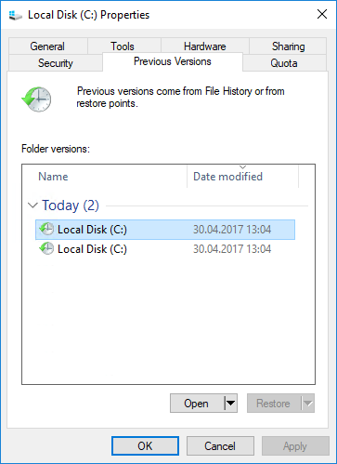
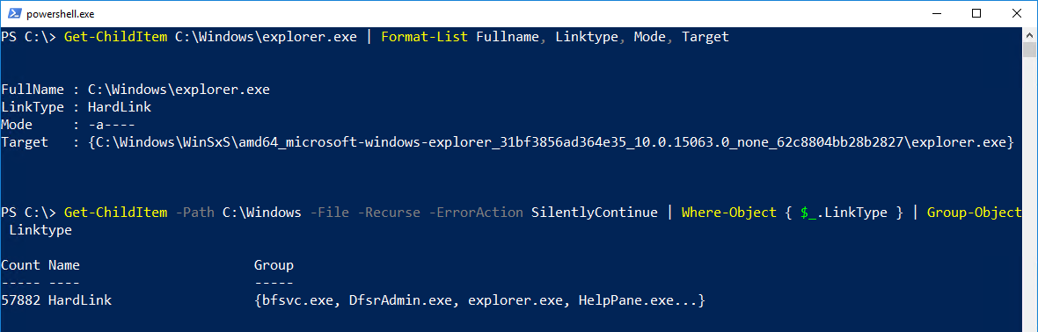
Why do Hardlinks/Symlinks exist?

Slide 22
KEEP
CALM
IT'S
DEMO
TIME
Corbel 57, 28

Slide 23
#region Episode 3
Adults only

Slide 24
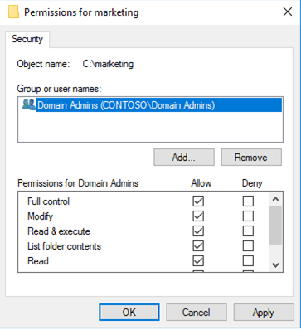
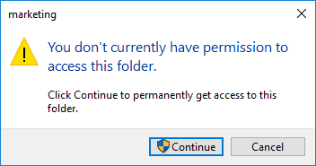
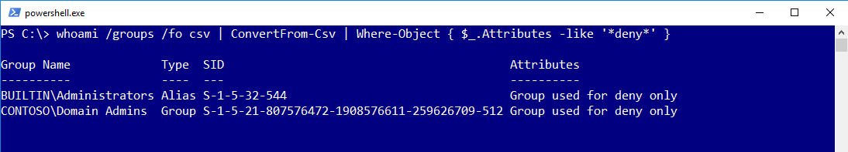
UAC trouble
Protected Administrator
  Standard mode
  Elevated mode
  (Run as Administrator)
Standard User Account

Slide 25
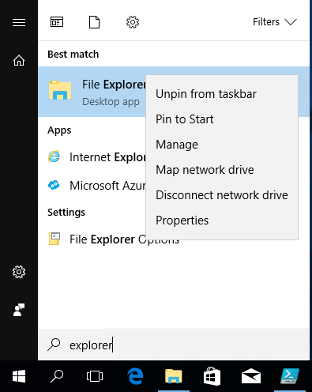
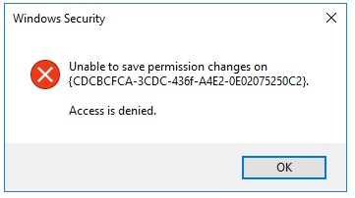
Trouble again with UAC
Very sophisticated:
Running Windows Explorer elevated
Requires Registry-Change
HKEY_CLASSES_ROOT\AppID\{CDCBCFCA-3CDC-436f-A4E2-0E02075250C2}\RunAs
Owner of the RegKey: "TrustedInstaller"

Slide 26
KEEP
CALM
IT'S
DEMO
TIME
Corbel 57, 28

Slide 27


Avoiding the glitches
Demo
Always (!) use your own groups to grant distinct permissions
Simplify your life:
Seattle Domain Admins
Domain Admins

Slide 28
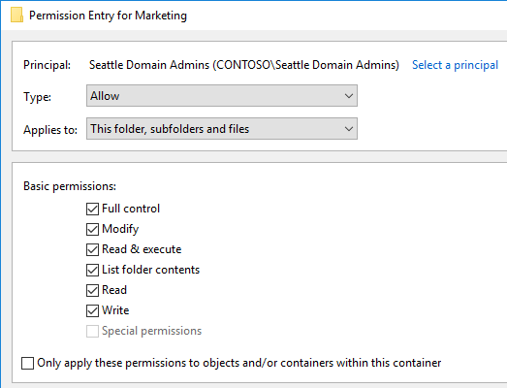
Demo
icacls.exe $fileshareroot /grant "$SeattleAdmins`:(OI)(CI)(F)"
# (OI) Object inherit
# (CI) Container inherit

Slide 29
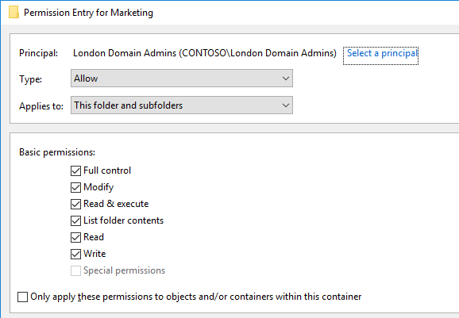
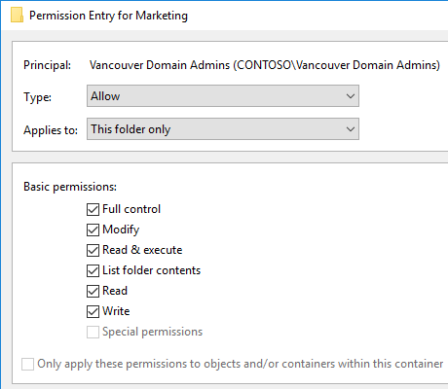
Demo
icacls.exe $fileshareroot /grant "$LondonAdmins`:(CI)(F)"
icacls.exe $fileshareroot /grant "$VancouerAdmins`:(F)"

Slide 30

Implicit deny vs. implict grant
Demo
ICACLS preserves the canonical ordering of ACE entries:
  Explicit denials
  Explicit grants
  Inherited denials
  Inherited grants

Slide 31
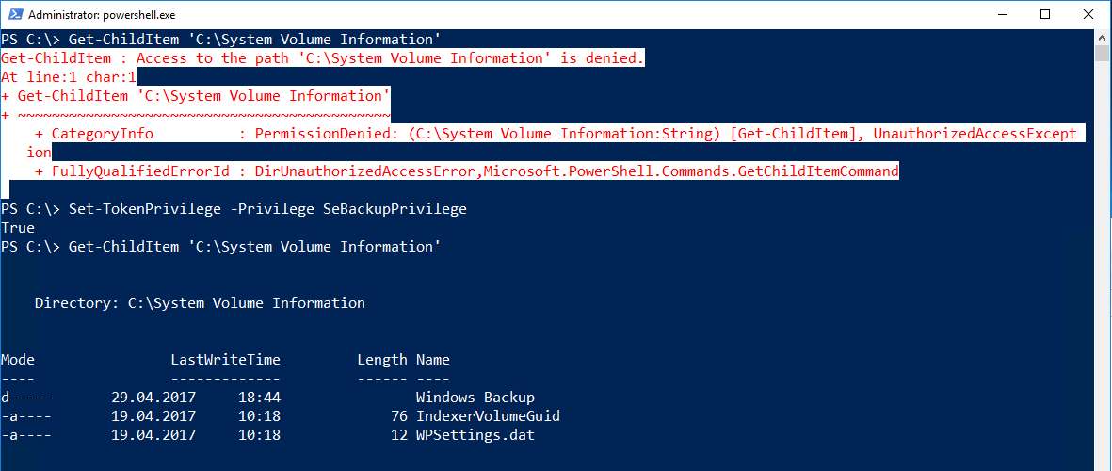
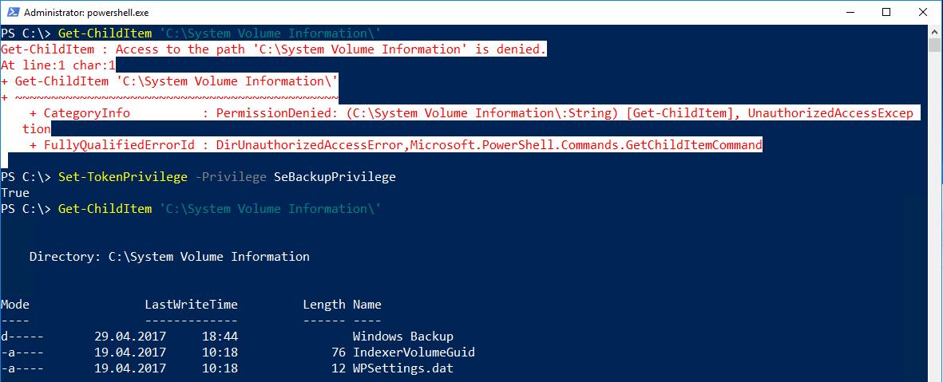
SeBackupPrivilege
http://www.leeholmes.com/blog/2010/09/24/adjusting-token-privileges-in-powershell/

Slide 32
Wrap up!
Remote administration is possible .. but awkward
Not a single solution is feature complete
(icacls.exe, takeown.exe, Get-ACL/Set-ACL ..)
No reason to disable UAC, use your own groups!

Slide 33
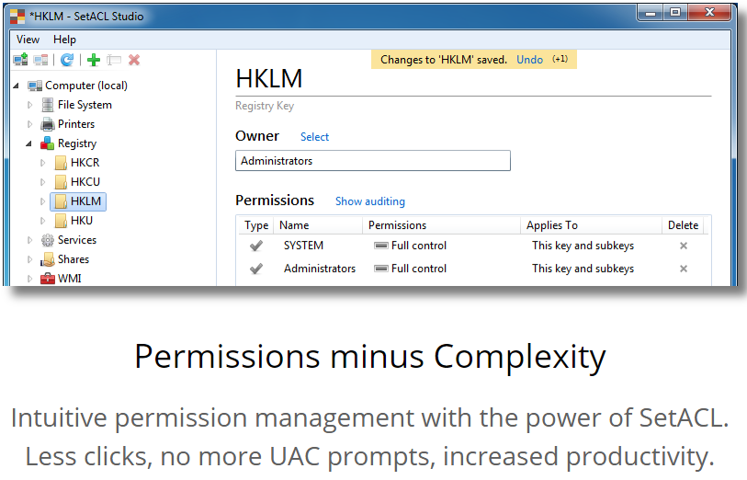
Tip: SetACL Studio by Helge Klein
Free for commercial use!

Slide 34
Thanks for participating. Questions?

