Slide 1
I hate PowerShell! about the bad, the worse and the ugly
Thorsten Butz
Notes:
PowerShell Conference Europe
Hannover, 2016
www.psconf.eu

Slide 2
# about_me
$speaker = @{
name='Thorsten Butz'
jobrole = 'Trainer','Consultant','Author'
certification = 'MC*','LPIC-2'
= @thorstenbutz
= gplus.to/thorstenbutz
= facebook.com/thbutz
= thorsten-butz.de
= slidingwindows.de
}
Notes:
____________________________________________________
____________________________________________________
____________________________________________________
____________________________________________________
____________________________________________________
____________________________________________________
____________________________________________________
____________________________________________________
____________________________________________________

Slide 3
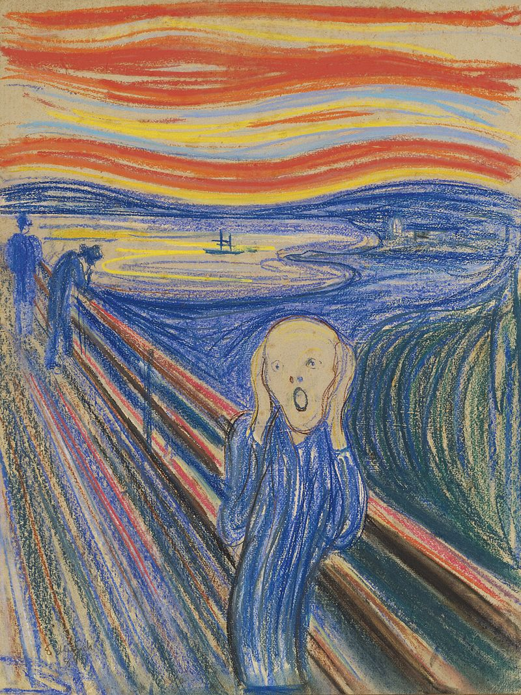
Notes:
Edvard Munch - en.wikipedia, public domain
https://commons.wikimedia.org/w/index.php?curid=37640961

Slide 4
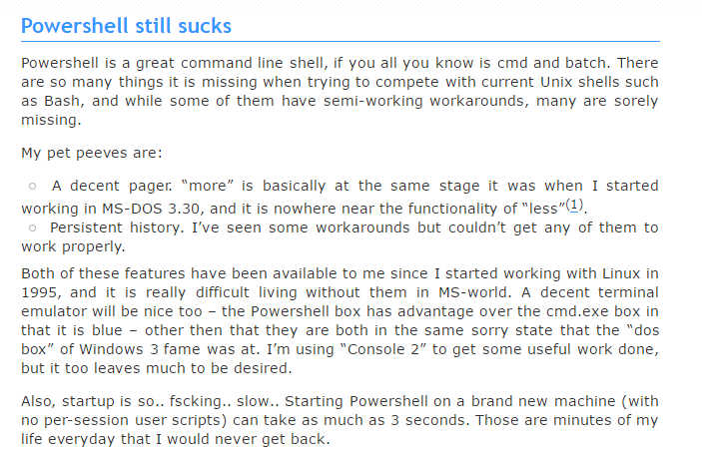
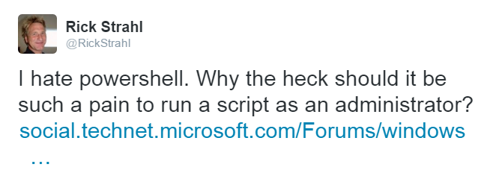
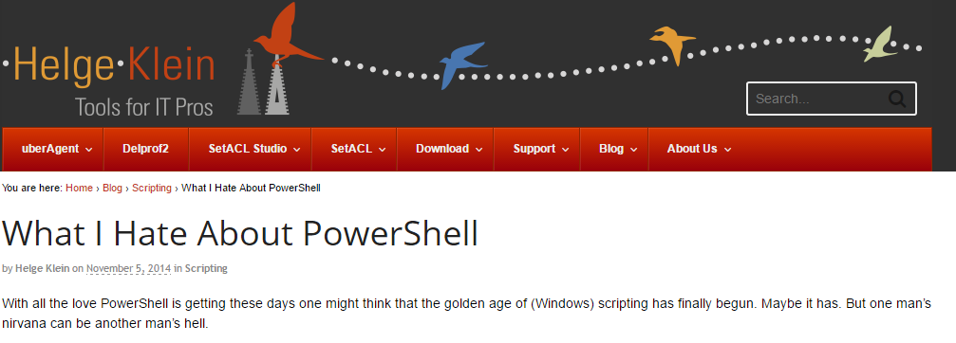
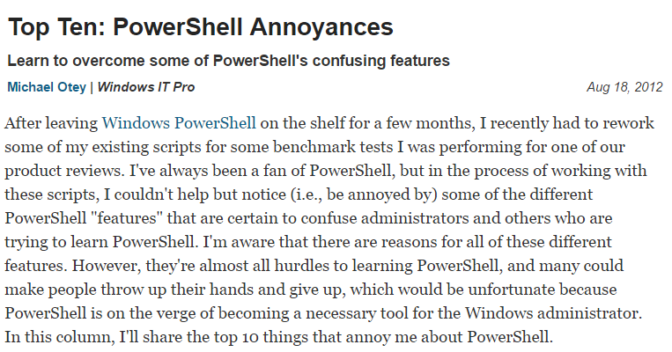
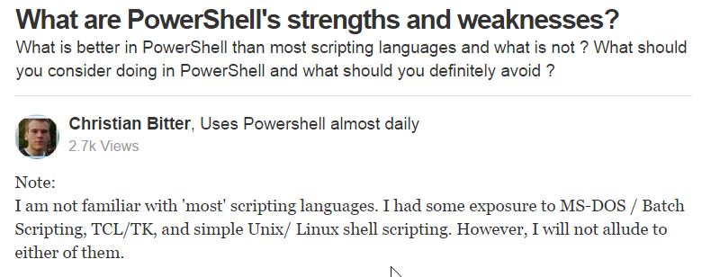
Notes:
Helge Klein
What I Hate About Powershell
https://helgeklein.com/blog/2014/11/hate-powershell/
What are PowerShell's strengths and weaknesses?
Christian Bitter
https://www.quora.com/What-are-PowerShells-strengths-and-weaknesses
Things n' Stuff
http://geek.co.il/2013/03/17/powershell-still-sucks
Michael Otey | Windows IT Pro
Top Ten: PowerShell Annoyances
http://windowsitpro.com/powershell/top-ten-powershell-annoyances
Rick Strahl (on Twitter)
https://twitter.com/rickstrahl/status/598171607492743168

Slide 5
KEEP
CALM
FOR
YOUR
MILEAGE
MAY VARY
Notes:
____________________________________________________
____________________________________________________
____________________________________________________
____________________________________________________
____________________________________________________
____________________________________________________
____________________________________________________
____________________________________________________
____________________________________________________

Slide 6
The usual suspects
ComparisonOperators
ExecutionPolicies
Write-Host –foregroundcolor 'blue'
Strict mode, variable declaration
WMI
Powershell –ne 'Bash'
$yourOpinionGoesHere
…
Notes:
____________________________________________________
____________________________________________________
____________________________________________________
____________________________________________________
____________________________________________________
____________________________________________________
____________________________________________________
____________________________________________________
____________________________________________________

Slide 7
My personal
TOP 1O LIST
of
PowerShell
annoyances
Notes:
____________________________________________________
____________________________________________________
____________________________________________________
____________________________________________________
____________________________________________________
____________________________________________________
____________________________________________________
____________________________________________________
____________________________________________________

Slide 8
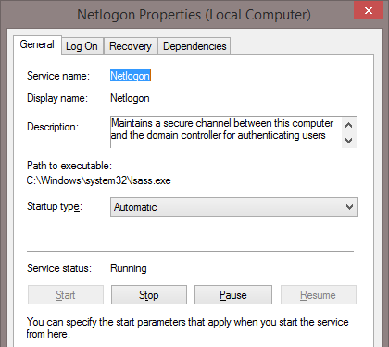
# 10: Walking on thin ice
[System.ServiceProcess.ServiceController]::GetServices()
Get-Service
Notes:
____________________________________________________
____________________________________________________
____________________________________________________
____________________________________________________
____________________________________________________
____________________________________________________
____________________________________________________
____________________________________________________
____________________________________________________

Slide 9
# 9: Lost in translation
'Mesut Özil' -replace 'ö','oe'
'Mesut Özil'.replace('ö','oe')
'Mario Götze' -replace '\bö','oe'
'Mario Götze'.replace('\bo','oe')
Notes:
____________________________________________________
____________________________________________________
____________________________________________________
____________________________________________________
____________________________________________________
____________________________________________________
____________________________________________________
____________________________________________________
____________________________________________________

Slide 10
# 8: Consinstency
1..5 | ForEach-Object
{
$_
}
while ($b -lt 5)
{
$b++
$b
}
ERROR
Notes:
____________________________________________________
____________________________________________________
____________________________________________________
____________________________________________________
____________________________________________________
____________________________________________________
____________________________________________________
____________________________________________________
____________________________________________________

Slide 11
# 7: Keep it simple?
Get-Process |
Where-Object { $_.WS -gt 40MB} |
Sort- Object WS -Descending
Get-Process |
where { $PSITEM.WS -gt 40MB } |
sort WS -Descending
ps | ? { $_.WS -gt 40MB } | sort WS -des
ps | ? WS -gt 40MB | sort WS -des
Notes:
____________________________________________________
____________________________________________________
____________________________________________________
____________________________________________________
____________________________________________________
____________________________________________________
____________________________________________________
____________________________________________________
____________________________________________________

Slide 12
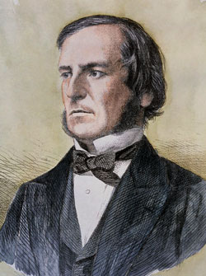
# 6: Mr Bool and the evil [switch]
Get-NetFirewallRule -Enabled true
New-ADUser 'Donald' -Enabled $true
Remove-ADUser 'Donald' -Confirm:$false
Notes:
____________________________________________________
____________________________________________________
____________________________________________________
____________________________________________________
____________________________________________________
____________________________________________________
____________________________________________________
____________________________________________________
____________________________________________________

Slide 13
# 5: Nice try …
Get-ADAccountAuthorizationGroup BloatT
Get-ADAccountAuthorizationGroup : An unspecified error has occurred
At line:1 char:1
+ Get-ADAccountAuthorizationGroup BloatT
+ ~~~~~~~~~~~~~~~~~~~~~~~~~~~~~~~~~~~~~~
+ CategoryInfo : NotSpecified: (BloatT:ADAccount) [Get-ADAccountAuthorizationGroup], ADException
+ FullyQualifiedErrorId : ActiveDirectoryServer:0,Microsoft.ActiveDirectory.Management.Commands.GetADAccountAuthorizationGr
Notes:
____________________________________________________
____________________________________________________
____________________________________________________
____________________________________________________
____________________________________________________
____________________________________________________
____________________________________________________
____________________________________________________
____________________________________________________

Slide 14
# 4: The impact of speed has been greatly exaggerated
$count = 10000
[System.Collections.ArrayList]$al = @()
foreach ($i in 1..$count) {
$test = Get-Random
$al.Add($test)
}
[array]$arr = @()
foreach ($i in 1..$count) {
$test = Get-Random
$arr += $test
}
DANGER
Notes:
____________________________________________________
____________________________________________________
____________________________________________________
____________________________________________________
____________________________________________________
____________________________________________________
____________________________________________________
____________________________________________________
____________________________________________________

Slide 15
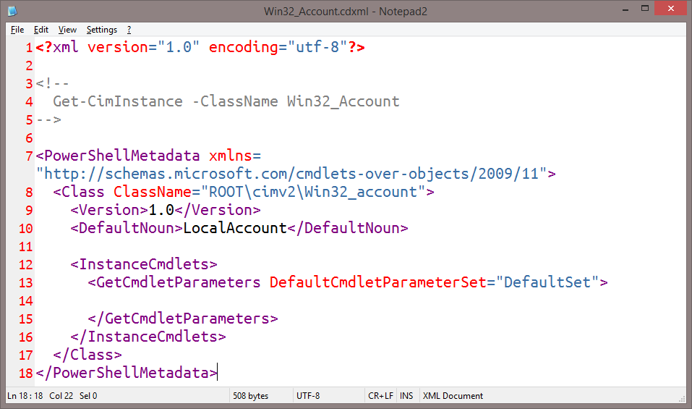
Number 3: CDXML
.. of PowerShell annoyances
Notes:
____________________________________________________
____________________________________________________
____________________________________________________
____________________________________________________
____________________________________________________
____________________________________________________
____________________________________________________
____________________________________________________
____________________________________________________

Slide 16
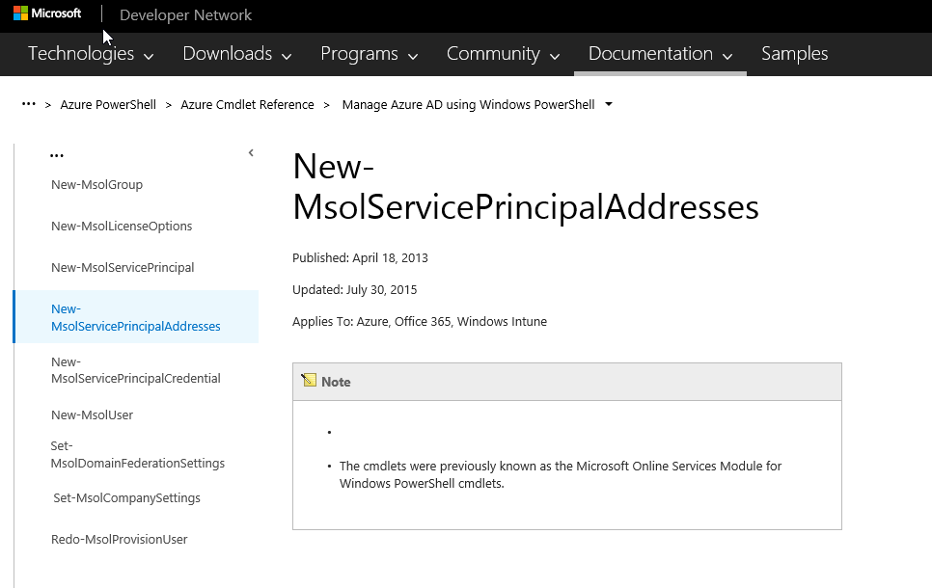
Number 2: Principiis obsta!
Notes:
"Principiis obsta" = Resist the beginnings
https://en.wikiquote.org/wiki/Ovid
https://msdn.microsoft.com/library/dn169221.aspx
Malformed cmdlets:
New-MsolServicePrincipalAddresses
Set-MsolDomainFederationSettings
Set-MsolCompanySettings

Slide 17
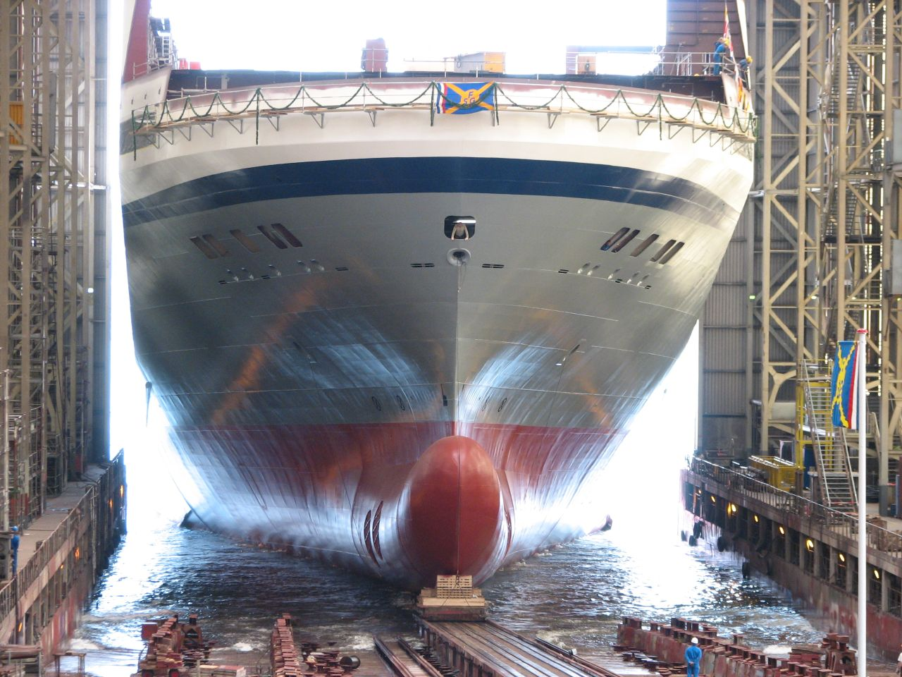
Notes:
https://upload.wikimedia.org/wikipedia/commons/e/ed/Stapellauf.jpg

Slide 18
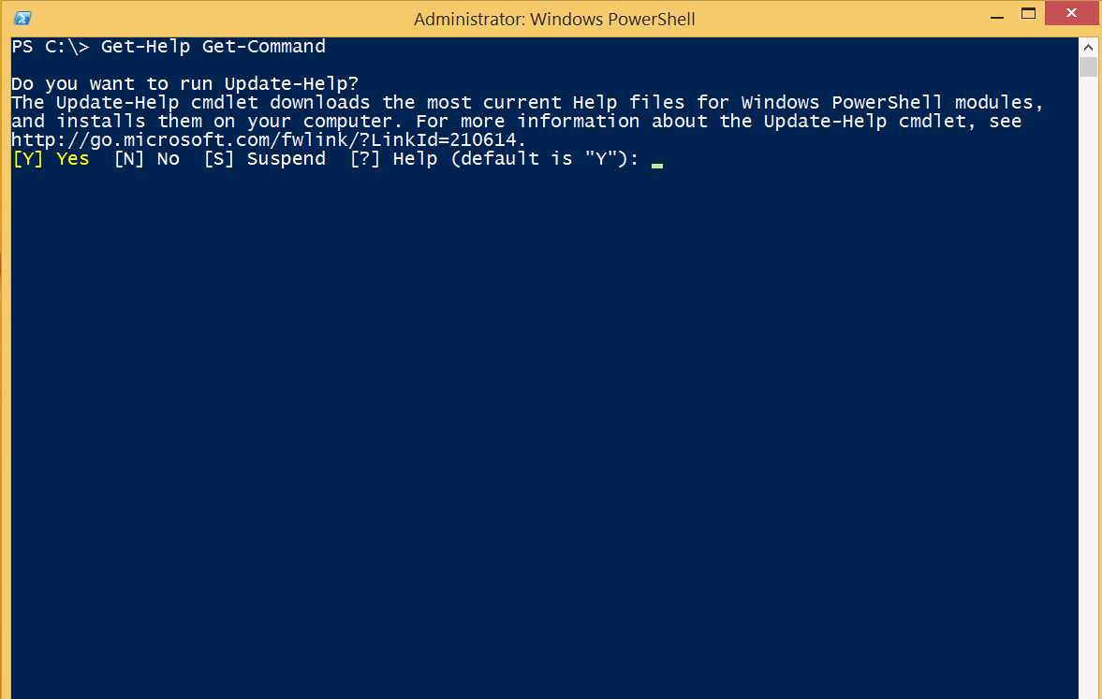
Number 1: To ship is to choose
Notes:
"Principiis obsta" = Resist the beginnings
https://en.wikiquote.org/wiki/Ovid
Malformed cmdlets:
New-MsolServicePrincipalAddresses
Set-MsolDomainFederationSettings
Set-MsolCompanySettings
Reference:
https://msdn.microsoft.com/library/dn169221.aspx

Slide 19
Devs? Ops?
Notes:
____________________________________________________
____________________________________________________
____________________________________________________
____________________________________________________
____________________________________________________
____________________________________________________
____________________________________________________
____________________________________________________
____________________________________________________

Slide 20
DevOpsification!
Notes:
____________________________________________________
____________________________________________________
____________________________________________________
____________________________________________________
____________________________________________________
____________________________________________________
____________________________________________________
____________________________________________________
____________________________________________________

Slide 21
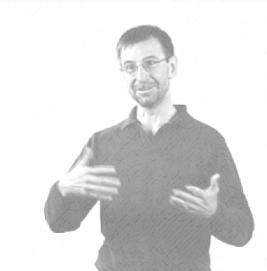
The monad manifesto
"Most solutions are home brewed and composed out of existing commands by administrators.
Most solutions are focused on either automating management or providing ad hoc fixes.
Most administrators are para-programmers. They either don’t have the desire, skill or (more often), the time to do sophisticated programming.
Most application developers won’t make their code manageable unless there is immediate and substantial user benefit"
Notes:
http://www.jsnover.com/Docs/MonadManifesto.pdf
Page 3:
"4 New Approaches
Monad takes new approaches to the issues of 1) building commands, 2) composing solutions 3) management models and 4) management GUIs. The Monad architecture flows from the following observations:
Most solutions are home brewed and composed out of existing commands by administrators.
2. Most solutions are focused on either automating management or providing ad hoc fixes.
3. Most administrators are para-programmers. They either don’t have the desire, skill or (more often), the time to do sophisticated programming.
4. Most application developers won’t make their code manageable unless there is immediate and substantial user benefit. "

Slide 22
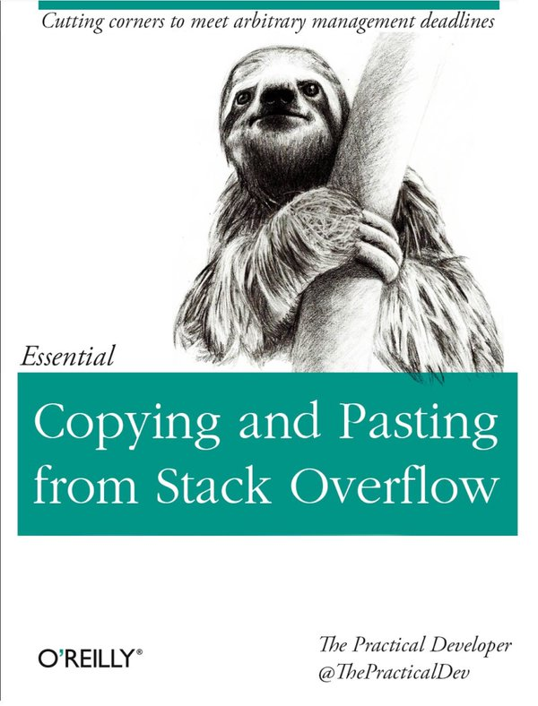
Notes:
https://twitter.com/nixcraft/status/705848396926464000

Slide 23
I love PowerShell !

Slide 24
Questions?
@thorstenbutz

Slide 25
Thank you!
@thorstenbutz

