Slide 1
Arrow ECS Training Get-KnowHow | Select-Object -property 'Essential'
Windows PowerShell v5: Die Neuerungen im Überblick
Thorsten Butz
Notes:
http://education.arrowecs.de/seminare
training.ecs.de@arrow.com
Tel.: 089 93099168

Slide 2
Agenda
Upgrade PS 5
(Einige) Neue Cmdlets
PackageManagent
[class]
-----------------------------------------------------------------------------------------------------------
= 1 h, 2 Demos, 20 Folien
Notes:
_________________________________________________________________________________________
_________________________________________________________________________________________
_________________________________________________________________________________________
_________________________________________________________________________________________
_________________________________________________________________________________________
_________________________________________________________________________________________
_________________________________________________________________________________________

Slide 3
Arrow Education – Trainings & Zertifizierungen
… deutschlandweite Abdeckung
> München
> Frankfurt
> Bochum
> Berlin
> Hamburg
… Modernste Lernumgebung
> Highend Laborumgebung
> Digitale Kursunterlagen
> Klimatisierte Kursräume
…Qualität
> Supportprofis als Trainer
> Lerngarantie
> Garantierte Kursdurchführung
> Zertifiziertes Testcenter
… Einmaliges Kursportfolio
> Citrix
> VMware
> Microsoft
> Check Point
> Uvm.
… innovative und zeitgemäße Lernmethoden
> Klassenraumtraining
> Virtual Classroom
> Elearning
> Videolearning
Notes:
_________________________________________________________________________________________
_________________________________________________________________________________________
_________________________________________________________________________________________
_________________________________________________________________________________________
_________________________________________________________________________________________
_________________________________________________________________________________________
_________________________________________________________________________________________

Slide 4
Arrow Education – Trainings & Zertifizierungen
… deutschlandweite Abdeckung
> München
> Frankfurt
> Bochum
> Berlin
> Hamburg
Empfohlene Microsoft Kurse:
Mastering Windows 2012 R2 & Windows 10 // Praxis.Workshop (5 Tage)
Automating Administration with Windows PowerShell MOC-10961 (5 Tage)
Installing and Configuring Windows 10 MOC-20697-1 (5 Tage)
… Modernste Lernumgebung
> Highend Laborumgebung
> Digitale Kursunterlagen
> Klimatisierte Kursräume
…Qualität
> Supportprofis als Trainer
> Lerngarantie
> Garantierte Kursdurchführung
> Zertifiziertes Testcenter
… Einmaliges Kursportfolio
> Citrix
> VMware
> Microsoft
> Check Point
> Uvm.
training.ecs.de@arrow.com
Tel.: 089 93099168
Notes:
_________________________________________________________________________________________
_________________________________________________________________________________________
_________________________________________________________________________________________
_________________________________________________________________________________________
_________________________________________________________________________________________
_________________________________________________________________________________________
_________________________________________________________________________________________

Slide 5
about_me
$speaker = @{
name = 'Thorsten Butz'
certification = 'MC*/LIPC-2'
focus = 'Scripting', 'ServerManagement'
= '@thorstenbutz'
= 'http://www.thorsten-butz.de'
}
Notes:
_________________________________________________________________________________________
_________________________________________________________________________________________
_________________________________________________________________________________________
_________________________________________________________________________________________
_________________________________________________________________________________________
_________________________________________________________________________________________
_________________________________________________________________________________________

Slide 6
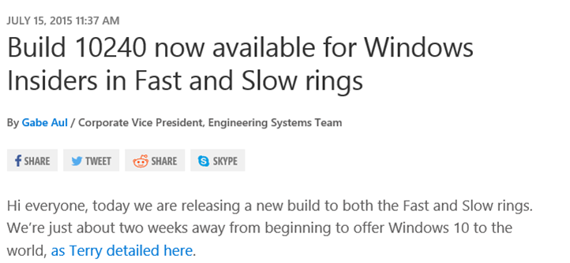
Windows 10 & PowerShell v5
RTM ?
Notes:
Erste Fassung einer "finalen" PowerShell 5:
Windows 10 Build 10240: Treshold 1
_________________________________________________________________________________________
_________________________________________________________________________________________
_________________________________________________________________________________________
_________________________________________________________________________________________
_________________________________________________________________________________________

Slide 7
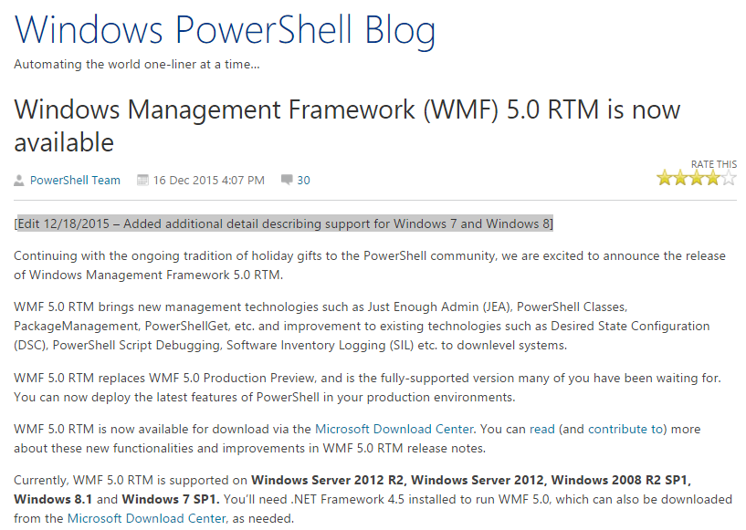
Notes:
http://blogs.msdn.com/b/powershell/archive/2015/12/16/windows-management-framework-wmf-5-0-rtm-is-now-available.aspx
_________________________________________________________________________________________
_________________________________________________________________________________________
_________________________________________________________________________________________
_________________________________________________________________________________________
_________________________________________________________________________________________
_________________________________________________________________________________________
_________________________________________________________________________________________

Slide 8
Notes:
"Download the correct package for your operating system and architecture.
The following architectures are supported.
Windows Server 2012 R2
x64: W2K12R2-KB3094174-x64.msu
Windows Server 2012
x64: W2K12-KB3094175-x64.msu
Windows Server 2008 R2 SP1
x64: W2K8R2-KB3094176-x64.msu
Windows 8.1
x64: W2K12R2-KB3094174-x64.msu
x86: Win8.1-KB3094174-x86.msu
Windows 7 SP1
x64: W2K8R2-KB3094176-x64.msu
x86: Win7-KB3094176-x86.msu"
Quelle
https://www.microsoft.com/en-us/download/confirmation.aspx?id=50395
http://www.heise.de/developer/meldung/PowerShell-5-fuer-Windows-Server-aber-nicht-fuer-aeltere-Clients-3046825.html
http://twitter.com/dotnetdoktor

Slide 9
(Wesentliche) Neuerungen in Windows PowerShell 5.0
Klassen (Neue Schlüsselworte: Class, Enum)
Neuer Stream: Information
Neue Cmdlets
ConvertFrom-String, Convert-String
Compress-Archive, Expand-Archive
Format-Hex
Get-Clipboard, Set-Clipboard
New-Guid
Export-ODataEndpointProxy
…
PackageManagement, PowerShellGet (basierend auf NuGet)
Notes:
https://technet.microsoft.com/en-us/library/hh857339.aspx#BKMK_new50
_________________________________________________________________________________________
_________________________________________________________________________________________
_________________________________________________________________________________________
_________________________________________________________________________________________
_________________________________________________________________________________________
_________________________________________________________________________________________

Slide 10
(Wesentliche) Verbesserungen in Windows PowerShell 5.0
Start-Transcript in der ISE nutzbar
Cmdlets
Symlink Support in Get-Item, Get-ChildItem
Get-ChildItem: neuer "depth" Parameter: Get-ChildItem -recurse -depth 2
Copy-Item kopiert Dateien in eine andere Session (via WinRM)
Get-Command zeigt eine neue Eigenschaft "Version"
DSC-Erweiterungen: Klassen, Intellisense/Debugging-Verbesserungen
Notes:
_________________________________________________________________________________________
_________________________________________________________________________________________
_________________________________________________________________________________________
_________________________________________________________________________________________
_________________________________________________________________________________________
_________________________________________________________________________________________
_________________________________________________________________________________________

Slide 11
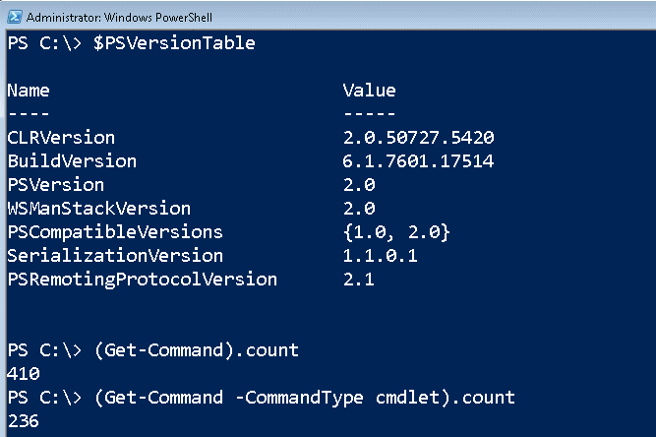
Windows 7 (SP1) PoSh v2
Notes:
_________________________________________________________________________________________
_________________________________________________________________________________________
_________________________________________________________________________________________
_________________________________________________________________________________________
_________________________________________________________________________________________
_________________________________________________________________________________________
_________________________________________________________________________________________

Slide 12
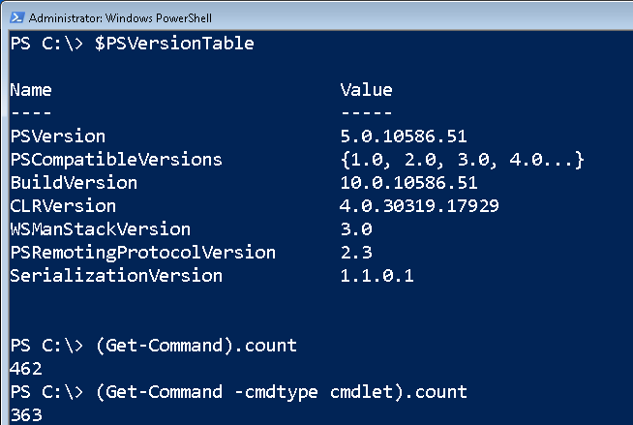
Windows 7 (SP1) PoSh v5
Notes:
_________________________________________________________________________________________
_________________________________________________________________________________________
_________________________________________________________________________________________
_________________________________________________________________________________________
_________________________________________________________________________________________
_________________________________________________________________________________________
_________________________________________________________________________________________

Slide 13
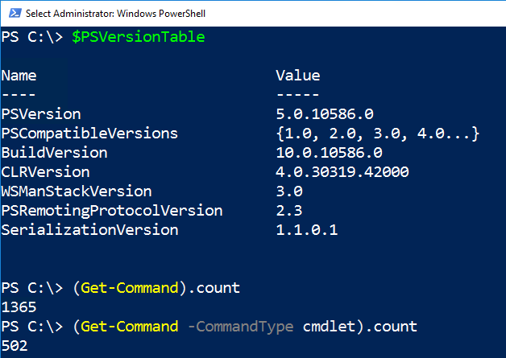
Windows 10 (1511) PoSh v5
Notes:
_________________________________________________________________________________________
_________________________________________________________________________________________
_________________________________________________________________________________________
_________________________________________________________________________________________
_________________________________________________________________________________________
_________________________________________________________________________________________
_________________________________________________________________________________________

Slide 14
Notes:
_________________________________________________________________________________________
_________________________________________________________________________________________
_________________________________________________________________________________________
_________________________________________________________________________________________
_________________________________________________________________________________________
_________________________________________________________________________________________
_________________________________________________________________________________________

Slide 15
Demo 1
Notes:
_________________________________________________________________________________________
_________________________________________________________________________________________
_________________________________________________________________________________________
_________________________________________________________________________________________
_________________________________________________________________________________________
_________________________________________________________________________________________
_________________________________________________________________________________________

Slide 16
Neue Cmdlets: Zipping
# PS < v5
$src = 'C:\logs\'
$dst = 'C:\backup\log.zip'
Add-Type -assembly 'System.IO.Compression.Filesystem'
[System.IO.Compression.ZipFile]::CreateFromDirectory($src, $dst)
# Simple
Compress-Archive -Path 'C:\logs\log1.txt' -DestinationPath 'C:\backup\log1.zip'
# Pipelining
Get-ChildItem -Path $HOME -Recurse -File -Include *.txt,*.png |
Compress-Archive -DestinationPath 'c:\backup\files.zip' # -Force
Notes:
http://www.heise.de/developer/artikel/Zippen-mit-PowerShell-5-0-2803617.html
_________________________________________________________________________________________
_________________________________________________________________________________________
_________________________________________________________________________________________
_________________________________________________________________________________________
_________________________________________________________________________________________
_________________________________________________________________________________________

Slide 17
Neues Cmdlet: Convert-String
# PowerShell v5
$nationalspieler = 'Manuel Neuer', 'Mats Hummels'
$nationalspieler | Convert-String -Example 'Manuel Neuer=NeuerM'
# Previously
$name = 'Manuel Neuer'
$name.Split()[1] + $name.Split()[0].Substring(0,1)
Notes:
$nationalspieler = 'Manuel Neuer', 'Mats Hummels'
# a: Just a string
$name = 'Manuel Neuer'
$name.Split()[1] + $name.Split()[0].Substring(0,1)
# b: Array
foreach ($name in $nationalspieler) {
$name.Split()[1] + $name.Split()[0].Substring(0,1)
}
$nationalspieler | ForEach-Object {
$_.Split()[1] + $_.Split()[0].Substring(0,1)
}

Slide 18
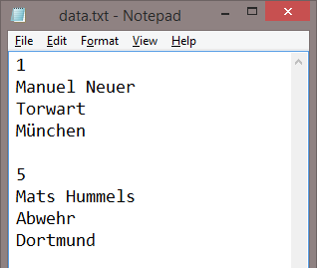
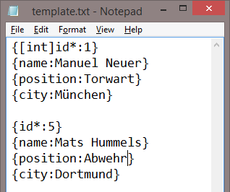
Neues Cmdlet: Convert-FromString
Get-Content -Path $datafile |
ConvertFrom-String -TemplateFile $template
Notes:
_________________________________________________________________________________________
_________________________________________________________________________________________
_________________________________________________________________________________________
_________________________________________________________________________________________
_________________________________________________________________________________________
_________________________________________________________________________________________
_________________________________________________________________________________________

Slide 19
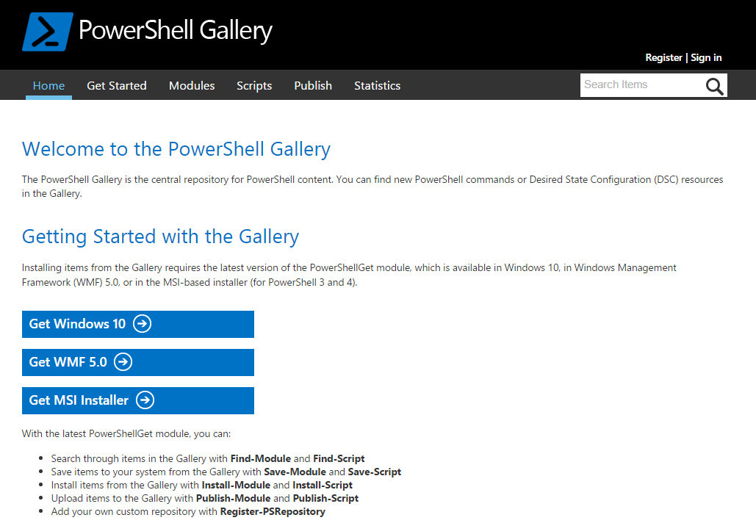
Package Management: PowerShell Gallery
Package Management
basiert auf NUGet
Notes:
Package Management basiert auf NUget:
https://www.nuget.org/
_________________________________________________________________________________________
_________________________________________________________________________________________
_________________________________________________________________________________________
_________________________________________________________________________________________
_________________________________________________________________________________________
_________________________________________________________________________________________
_________________________________________________________________________________________

Slide 20
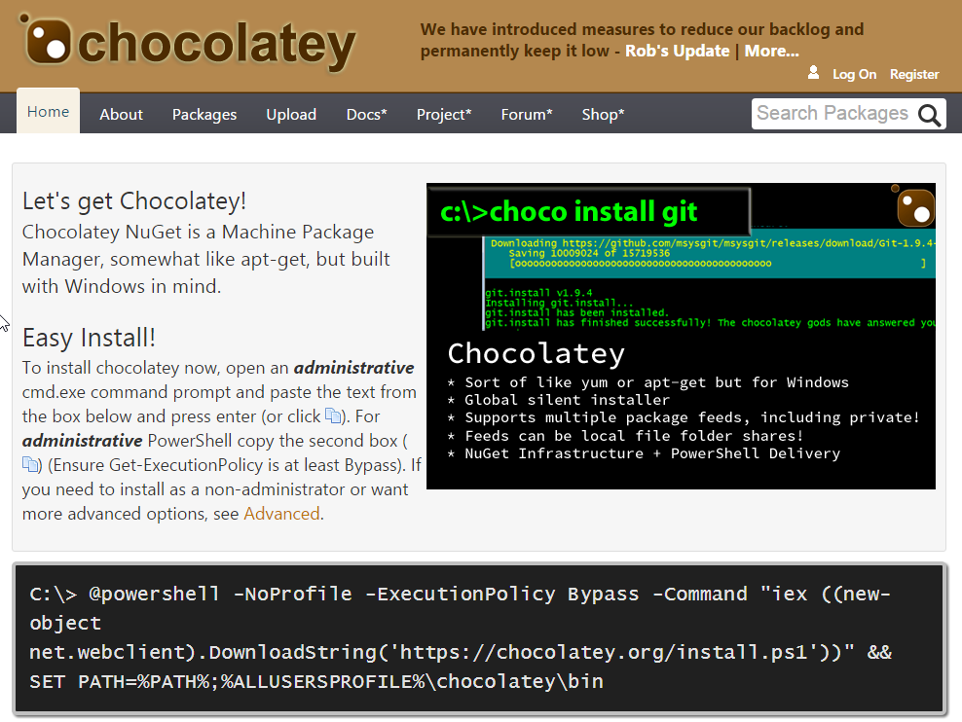
Package Management: Chocolatey
Setup vor
PS v5
Notes:
Chocolatey ist ein "Community"-Projekt zur unbeaufsichtigten Installation von Software,
vergleichbar mit den Linux-Tools "dpkg/apt".
https://chocolatey.org/
Basiert ebenfalls auf NUget:
https://www.nuget.org/
Alternative:
https://ninite.com/
_________________________________________________________________________________________
_________________________________________________________________________________________
_________________________________________________________________________________________
_________________________________________________________________________________________

Slide 21
Neues Schlüsselwort: [class]
"Classes are not objects, and objects are not classes. An object is an instance of a class." (Ed Wilson)
Notes:
http://blogs.technet.com/b/heyscriptingguy/archive/2015/08/31/introduction-to-powershell-5-classes.aspx
_________________________________________________________________________________________
_________________________________________________________________________________________
_________________________________________________________________________________________
_________________________________________________________________________________________
_________________________________________________________________________________________
_________________________________________________________________________________________
_________________________________________________________________________________________

Slide 22
Klassen und Objekte
New-Object -TypeName DateTime # An object
Class Server # A "blueprint"
{
[string]$Computername
[vendor]$Vendor
[string]$Model
}
New-Object -TypeName Server # An object
Notes:
_________________________________________________________________________________________
_________________________________________________________________________________________
_________________________________________________________________________________________
_________________________________________________________________________________________
_________________________________________________________________________________________
_________________________________________________________________________________________
_________________________________________________________________________________________

Slide 23
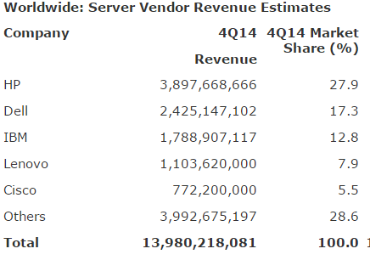
Neues Schlüsselwort: [enum]
Enum Vendor
{
HP = 1
Dell = 2
IBM = 3
Lenovo = 4
Ciso = 5
}
http://www.gartner.com/newsroom/id/2997118
Notes:
Gartner Says Worldwide Server Market Grew 4.8 Percent in Shipments, While Revenue Increased 2.2 Percent in Fourth Quarter of 2014
http://www.gartner.com/newsroom/id/2997118
_________________________________________________________________________________________
_________________________________________________________________________________________
_________________________________________________________________________________________
_________________________________________________________________________________________
_________________________________________________________________________________________

Slide 24
Demo 2
Notes:
_________________________________________________________________________________________
_________________________________________________________________________________________
_________________________________________________________________________________________
_________________________________________________________________________________________
_________________________________________________________________________________________
_________________________________________________________________________________________
_________________________________________________________________________________________

Slide 25
Save the date: 28. Jan. 2016, 17:15 h
Windows Server 2016: Die Neuerungen im Überblick
Thorsten Butz http://education.arrowecs.de/seminare/kurse/training_kurse.cfm?courseId=AAAAELM
Notes:
http://education.arrowecs.de/seminare/kurse/training_kurse.cfm?courseId=AAAAELM
_________________________________________________________________________________________
_________________________________________________________________________________________
_________________________________________________________________________________________
_________________________________________________________________________________________
_________________________________________________________________________________________
_________________________________________________________________________________________
_________________________________________________________________________________________

