Slide 1
Arrow ECS Training
Windows Server 2016: Die Neuerungen im Überblick
Bei technischen Problemen mit GoToMeeting kontaktieren Sie:
vclsupport@arrowecs.de
Notes:
http://education.arrowecs.de/seminare
training.ecs.de@arrow.com
Tel.: 089 93099168

Slide 2
Arrow ECS Training
Get-KnowHow | Select-Object -property 'Essential'
Windows Server 2016: Die Neuerungen im Überblick
Thorsten Butz
Notes:
http://education.arrowecs.de/seminare
training.ecs.de@arrow.com
Tel.: 089 93099168

Slide 3
Agenda
Windows Server 2016: Die Neuerungen im Überblick
Einige
Editionen, Lizensierung
Hyper-V, Container
Nano-Installationsoption
"The Big Picture"
-----------------------------------------------------------------------------------------------------------
= 1 h, 2 Demos, 20 Folien
Notes:
_________________________________________________________________________________________
_________________________________________________________________________________________
_________________________________________________________________________________________
_________________________________________________________________________________________
_________________________________________________________________________________________
_________________________________________________________________________________________
_________________________________________________________________________________________

Slide 4

Arrow Education –
Trainings & Zertifizierungen
… deutschlandweite Abdeckung
> München
> Frankfurt
> Bochum
> Berlin
> Hamburg
… Modernste Lernumgebung
> Highend Laborumgebung
> Digitale Kursunterlagen
> Klimatisierte Kursräume
…Qualität
> Supportprofis als Trainer
> Lerngarantie
> Garantierte Kursdurchführung
> Zertifiziertes Testcenter
… Einmaliges Kursportfolio
> Citrix
> VMware
> Microsoft
> Check Point
> Uvm.
… innovative und zeitgemäße Lernmethoden
> Klassenraumtraining
> Virtual Classroom
> Elearning
> Videolearning
Notes:
_________________________________________________________________________________________
_________________________________________________________________________________________
_________________________________________________________________________________________
_________________________________________________________________________________________
_________________________________________________________________________________________
_________________________________________________________________________________________
_________________________________________________________________________________________

Slide 5

Arrow Education –
Trainings & Zertifizierungen
… deutschlandweite Abdeckung
> München
> Frankfurt
> Bochum
> Berlin
> Hamburg
Empfohlene Microsoft Kurse:
Mastering Windows 2012 R2 & Windows 10 // Praxis.Workshop (5 Tage)
Automating Administration with Windows PowerShell MOC-10961 (5 Tage)
Installing and Configuring Windows 10 MOC-20697-1 (5 Tage)
… Modernste Lernumgebung
> Highend Laborumgebung
> Digitale Kursunterlagen
> Klimatisierte Kursräume
…Qualität
> Supportprofis als Trainer
> Lerngarantie
> Garantierte Kursdurchführung
> Zertifiziertes Testcenter
… Einmaliges Kursportfolio
> Citrix
> VMware
> Microsoft
> Check Point
> Uvm.
training.ecs.de@arrow.com
Tel.: 089 93099168
Notes:
_________________________________________________________________________________________
_________________________________________________________________________________________
_________________________________________________________________________________________
_________________________________________________________________________________________
_________________________________________________________________________________________
_________________________________________________________________________________________
_________________________________________________________________________________________

Slide 6


about_me
$speaker = @{
name = 'Thorsten Butz'
certification = 'MC*/LIPC-2'
focus = 'Scripting', 'ServerManagement'
= '@thorstenbutz'
= 'http://www.thorsten-butz.de'
}
Notes:
_________________________________________________________________________________________
_________________________________________________________________________________________
_________________________________________________________________________________________
_________________________________________________________________________________________
_________________________________________________________________________________________
_________________________________________________________________________________________
_________________________________________________________________________________________

Slide 7
Previously …
NT 5.0 Windows 2000 // 2000
NT 5.1 Windows XP // 2001
NT 5.2 Windows Server 2003 // 2003
NT 5.2 Windows Server 2003 (R2) // 2005
NT 6 Windows Vista // 2006
NT 6 Windows Server 2008 // 2008
NT 6.1 Windows 7 / WS2008 R2 // 2009
NT 6.2 Windows 8 / WS 2012 // 2012
NT 6.3 Windows 8.1 / WS 2012 R2 // 2013
NT 10 Windows 10 // 2015
NT 10 Window Server "vNext" // 2016
Notes:
Rot markiert: Client und Server OS wurden gemeinsam veröffentlicht.
_________________________________________________________________________________________
_________________________________________________________________________________________
_________________________________________________________________________________________
_________________________________________________________________________________________
_________________________________________________________________________________________
_________________________________________________________________________________________

Slide 8
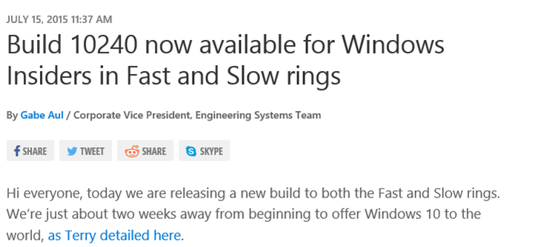
Windows as a Service
Windows 10
Jul. 2015 Threshold 1
Nov. 2015 Threshold 2
Redstone
____ 2016
Notes:
https://blogs.windows.com/windowsexperience/2015/07/15/build-10240-now-available-for-windows-insiders-in-fast-and-slow-rings
_________________________________________________________________________________________
_________________________________________________________________________________________
_________________________________________________________________________________________
_________________________________________________________________________________________
_________________________________________________________________________________________
_________________________________________________________________________________________

Slide 9

The software defined datacenter
  Compute
  Core OS, Hyper-V, Containers
  Networking
  SDN, integrated NAT, ..
  Storage
  Storage replica, Storage Spaces direct, ..
Virtualize
everything!
Notes:
_________________________________________________________________________________________
_________________________________________________________________________________________
_________________________________________________________________________________________
_________________________________________________________________________________________
_________________________________________________________________________________________
_________________________________________________________________________________________
_________________________________________________________________________________________

Slide 10

Codename: Redstone
Neues Lizenzmodell
Installationsoption: Nano Server
Hyper-V Verbesserungen
  "Nested virtualization"
  Shielded VMS
  Miniaturisierter Host (und VMs)
  Rolling cluster upgrades
  (WS 2012 R2 & WS 2016)
Container
  Windows Server Container
  Hyper-V Container
  Docker support
Notes:
http://minecraft-de.gamepedia.com/Redstone
_________________________________________________________________________________________
_________________________________________________________________________________________
_________________________________________________________________________________________
_________________________________________________________________________________________
_________________________________________________________________________________________
_________________________________________________________________________________________
_________________________________________________________________________________________

Slide 11
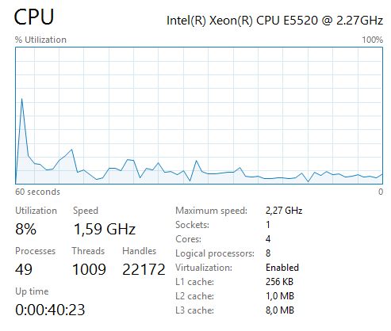
Lizensierung
Lizensierung pro CORE (zuvor: CPU)
Minimum pro physischem Server:
  2 SOCKETs
  8 COREs je SOCKET
  = Minimum 16 COREs
Wie gehabt:
  Standard Edition: 1 + 2 OSE
  Datacenter Edition: ∞ OSE
Notes:
OSE: Operating System Environment
Quellen :
"Windows Server 2016 and System Center 2016
Standard and Datacenter Editions Pricing and licensing FAQ December 2015"
https://t.co/fR2ybzibVx
Windows Server 2016 Standard and Datacenter Editions Licensing Datasheet
https://t.co/H1bu72R65v
Mary Jo Foley: Microsoft Windows Server 2016 to move to per-core licensing
http://www.zdnet.com/article/microsoft-windows-server-2016-to-move-to-per-core-licensing/
Wes Miller (Twitter)
https://twitter.com/getwired/status/672498239552098305

Slide 12
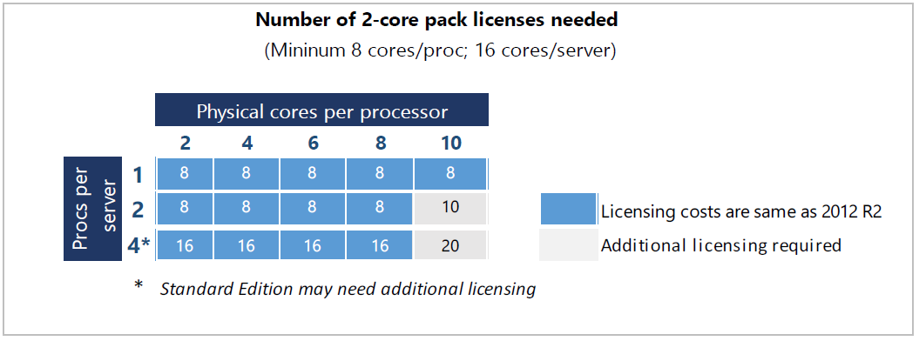
Lizenisierung: WS 2012 R2 vs. WS 2016
Quelle: Windows Server 2016 Standard and Datacenter Editions Licensing Datasheet
Notes:
_________________________________________________________________________________________
_________________________________________________________________________________________
_________________________________________________________________________________________
_________________________________________________________________________________________
_________________________________________________________________________________________
_________________________________________________________________________________________
_________________________________________________________________________________________

Slide 13
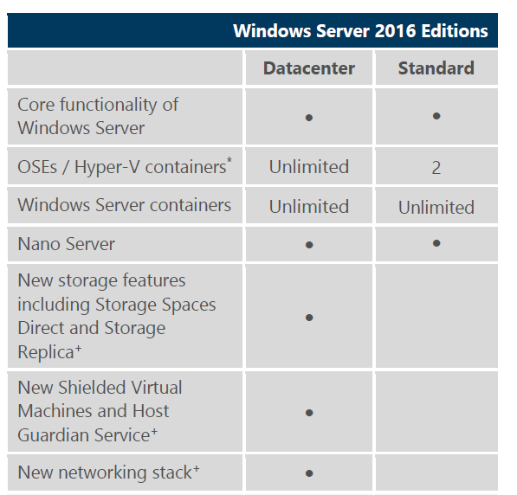
Editionen
Standard: 882 $
Datacenter: 6.155 $
Quelle (ebd.): Windows Server 2016 Standard and
Datacenter Editions Licensing Datasheet
Notes:
_________________________________________________________________________________________
_________________________________________________________________________________________
_________________________________________________________________________________________
_________________________________________________________________________________________
_________________________________________________________________________________________
_________________________________________________________________________________________
_________________________________________________________________________________________

Slide 14

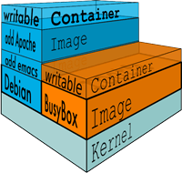
Container
Linux Container: docker.com
Container in WS 2016
  Hyper-V Container
  Hyper-V erforderlich
  Windows Server Container
  Hyper-V nicht erforderlich
  Docker Container
Abbildungen: www.docker.com/what-docker
Notes:
“Docker containers wrap up a piece of software in a complete filesystem that contains everything it needs to run: code, runtime, system tools, system libraries – anything you can install on a server. This guarantees that it will always run the same, regardless of the environment it is running in.”
https://www.docker.com/what-docker
_________________________________________________________________________________________
_________________________________________________________________________________________
_________________________________________________________________________________________
_________________________________________________________________________________________

Slide 15
Storage
Storage Spaces Direct
  Hyper-converged (VMs)
  Converged (multiple Server)
ReFS
  Effiziente Snapshots/Checkpoints und Sicherungen durch Änderungen der Metadaten
  Manipulation von VHDX-Dateien durch ändern der Metadaten: hohe Geschwindigkeit
Storage Replica
  Volumen- und blockbasierte Replizierung zwischen verschiedenen Hosts
SMB 3.1.1
Notes:
http://blogs.technet.com/b/josebda/archive/2015/05/05/what-s-new-in-smb-3-1-1-in-
the-windows-server-technical-preview-2.aspx
https://www.veeam.com/de/videos/windows-server-2016-neuerungen-ueberblick-de-7160.html
_________________________________________________________________________________________
_________________________________________________________________________________________
_________________________________________________________________________________________
_________________________________________________________________________________________

Slide 16
Hyper-V Verbesserungen
Änderungen im laufenden Betrieb
  "Hot Add/Remove" von Netzwerkkarten
  Änderungen des Hauptspeichers
Cluster Rolling Upgrades
PowerShell Direct (via VMBus)
"Nested virtualization"
Integriertes NAT/IP-Masquerading
"Shielded VMs"
Verschlüsselte VMs, können auf keiner anderen Hardware starten
Notes:
https://technet.microsoft.com/en-us/library/dn765472.aspx
http://www.aidanfinn.com/?p=17424
https://hyperv.veeam.com/blog/new-features-windows-server-hyper-v-2016/
http://www.thomasmaurer.ch/2015/05/whats-new-in-windows-server-2016-hyper-v/
_________________________________________________________________________________________
_________________________________________________________________________________________
_________________________________________________________________________________________
_________________________________________________________________________________________
_________________________________________________________________________________________

Slide 17
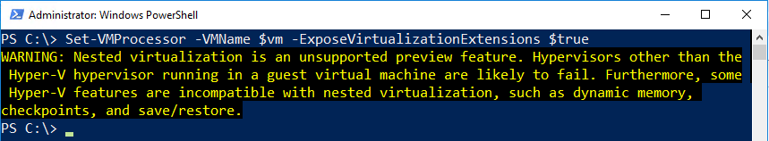
Nested VMs
Supported OS: WS 2016, W10 Build 10565
Dynamic memory: OFF
Minimum RAM für VM: 4 GB
VM NIC: MAC Address Spoofing: ON
Hardware: Intel VT-x
Notes:
Microsoft stellt ein Script zur Anpassung bereit, das mit dem folgenden Aufruf direct aus dem Web genutzt warden kann (als 1-Zeiler interpretieren):
Invoke-WebRequest https://raw.githubusercontent.com/Microsoft/Virtualization-Documentation/master/hyperv-tools/Nested/Enable-NestedVm.ps1 -OutFile ~/Enable-NestedVm.ps1
~/Enable-NestedVm.ps1 -VmName "VmName"
Mehr:
http://www.thomasmaurer.ch/2015/10/hyper-v-nested-virtualization-in-windows-10-build-10565/
http://www.thomasmaurer.ch/2015/11/nested-virtualization-in-windows-server-2016-and-windows-10/
_________________________________________________________________________________________
_________________________________________________________________________________________

Slide 18
Demo 1
Notes:
## Weitere Beispiele: http://www.thorsten-butz.de/neuerungen_ws2016
# Name of the Hyper-V host
$vm = 'sv1'
# Stop VM:
Stop-VM -VMName $vm
# Get information about relevant features for newsted virt.
(Get-VMProcessor -VMName $vm).ExposeVirtualizationExtensions
(Get-VMNetworkAdapter -VMName $vm).MacAddressSpoofing
Get-VMMemory -VMName $vm | fl Startup, Dyn*
# Set required
Set-VMProcessor -VMName $vm -ExposeVirtualizationExtensions $true
Set-VMNetworkAdapter -VMName $vm -MacAddressSpoofing On
Set-VMMemory -VMName $vm -DynamicMemoryEnabled:$false -StartupBytes 4GB
# Start
Start-VM -VMName $vm

Slide 19
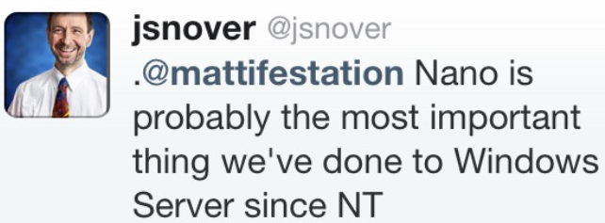
Notes:
https://twitter.com/jsnover/status/593786221404422144
_________________________________________________________________________________________
_________________________________________________________________________________________
_________________________________________________________________________________________
_________________________________________________________________________________________
_________________________________________________________________________________________
_________________________________________________________________________________________
_________________________________________________________________________________________

Slide 20

Nano server (codename: Tuva)
Installationsabbild NanoServer: 134 MB
"Zero foot print": keine Rollen und Funktionen an Bord
Verwendungszweck 1: "Compute clusters"
  Hyper-V-Host
  Storage: SoFS, etc.
Verwendungszweck 2: "born-in-the-cloud”-Anwendungen
Notes:
https://de.wikipedia.org/wiki/Tuwa
http://windowsitpro.com/windows-server/top-ten-what-you-need-know-about-microsoft-nano-server
_________________________________________________________________________________________
_________________________________________________________________________________________
_________________________________________________________________________________________
_________________________________________________________________________________________
_________________________________________________________________________________________
_________________________________________________________________________________________

Slide 21
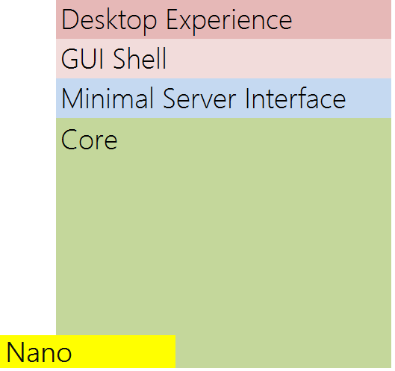
Nano vs. Core vs. GUI Shell
Installationsgröße
>500 MB vs. < 4 GB
Wichtige Updates in 2014:
9 vs. 23 vs. 26
Kritische Updates in 2014:
2 vs. 8 vs. 23
Hierdurch notwendige Neustarts:
3 vs. 6 vs. 11
*
* Zahlen/Hochrechnung: Veeam
Notes:
http://www.thomasmaurer.ch/2015/12/recording-best-of-windows-server-2016-the-new-foundation-of-windows/
_________________________________________________________________________________________
_________________________________________________________________________________________
_________________________________________________________________________________________
_________________________________________________________________________________________
_________________________________________________________________________________________
_________________________________________________________________________________________

Slide 22
Demo 2
Notes:
## Weitere Beispiele: http://www.thorsten-butz.de/neuerungen_ws2016
# Learn more: http://aka.ms/nanoserver
# Nano creation module (from WS 2016 ISO)
Import-Module C:\NanoServer_TP4\NanoServerImageGenerator.psm1
# Variables
$password =
ConvertTo-SecureString -AsPlainText -Force -String 'Pa$$w0rd'
$iso_X =
'C:en_windows_server_2016_technical_preview_4_x64_dvd_7258292\'
# Example: 1 Nano creation: GEN 1 VM
New-NanoServerImage `
-MediaPath $iso_x `
-BasePath C:\NanoServer_TP4\Base `
-TargetPath C:\NanoServer_TP4\myNano1.vhd `
-GuestDrivers -EnableRemoteManagementPort `
-AdministratorPassword $password `
-Language en-US `
-ComputerName ('tuva' + (get-random)) `
-Packages 'Microsoft-NanoServer-DNS-Package

Slide 23
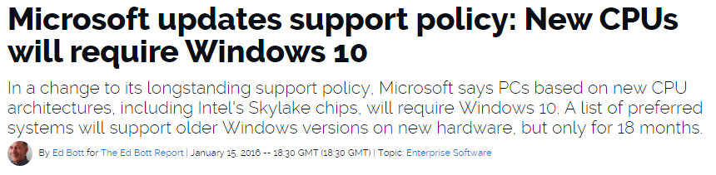
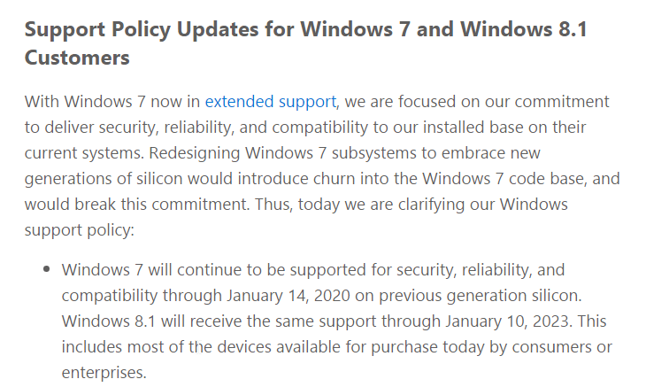
Das Ende einer Ära: Adieu Downgrade
Notes:
a) Microsoft updates support policy: New CPUs will require Windows 10 (Ed Boot:)
http://www.zdnet.com/article/microsoft-updates-support-policy-new-cpus-will-require-windows-10/
b) Microsoft: Support für neue Prozessoren zukünftig nur noch beim neuesten Windows
(Thorsten Leemhuis)
http://www.heise.de/newsticker/meldung/Microsoft-Support-fuer-neue-Prozessoren-zukuenftig-nur-noch-beim-neuesten-Windows-3072791.html
c) Windows 10 Embracing Silicon Innovation (Terry Myerson)
https://blogs.windows.com/windowsexperience/2016/01/15/windows-10-embracing-silicon-innovation/
"Windows 7 will continue to be supported for security, reliability, and compatibility through January 14, 2020 on previous generation silicon. Windows 8.1 will receive the same support through January 10, 2023. This includes most of the devices available for purchase today by consumers or enterprises."

Slide 24
Windows 10 und Windows Server 2016: ein (vorläufiges) Fazit
Das beständige Downgrade (der Clients) wird zukünftig sehr "schwierig"
Die Serverdichte kann erheblich gesteigert werden
Die neue Plattform macht ein Umdenken/Umgewöhnen des täglichen Arbeitens erforderlich
Hyper-V + Container + Nano –eq 'Most Important'
Notes:
_________________________________________________________________________________________
_________________________________________________________________________________________
_________________________________________________________________________________________
_________________________________________________________________________________________
_________________________________________________________________________________________
_________________________________________________________________________________________
_________________________________________________________________________________________

Slide 25
Save the date:
02. Feb. 2016, 17:15 h
Citrix - Update von NetScaler 10.1 und 10.5 auf NetScaler 11
http://education.arrowecs.de/seminare/kurse/training_kurse.cfm?courseId=AAAAEMR
Notes:
http://education.arrowecs.de/seminare/kurse/training_kurse.cfm?courseId=AAAAELM
_________________________________________________________________________________________
_________________________________________________________________________________________
_________________________________________________________________________________________
_________________________________________________________________________________________
_________________________________________________________________________________________
_________________________________________________________________________________________

